Slide 1
Utility of Global Distance Field in Shadowing NetEase Summer Internship Show 2019-08-08
导师：聂明华
周洋 HZS13760

Slide 2
展示内容概述
The main work done in this internship, that is, the content of this exhibition: Research on the use of S DistanceField Field Unity implementation: Offline baking of local SDF smodels Unity implementation: Global SDF for real-time maintenance, global Distance Field Unity implementation: GDF-based real-time soft shadows and ambient masking Other jobs in the internship are not repeated in the presentation: Study on distance Field management methods in UE4 and understand how DFAO is implemented Implementation of offline baking SDF algorithm, for a source of C-engineering, and then re-implemented and introduced in parallelization on the Unity platform Reading notes for documents, official documents, etc.

Slide 3
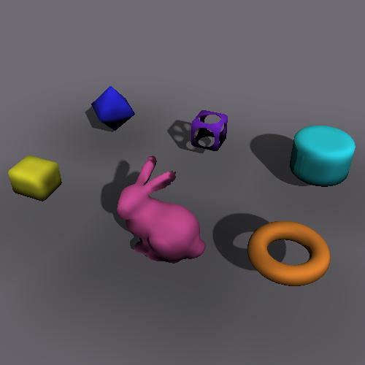
距离场简介
Distance field is a form of mapping in 2D/3D space: from any point p, the distance to the nearest boundary (2D) or plane (3D) in the space is d s SDF (p). Distance fields have many categories, sDF is one of them, which is characterized by distinguishing the inner and outer properties of the grid, with a positive distance outside the grid and a negative one.
SDF's application in 2D space is mainly font anti-walking, proposed by Valve in 2006 Applications of SDF in 3D space include collision detection, model representation and deformation, ambient occlusion, soft shadowing, etc.

Slide 4
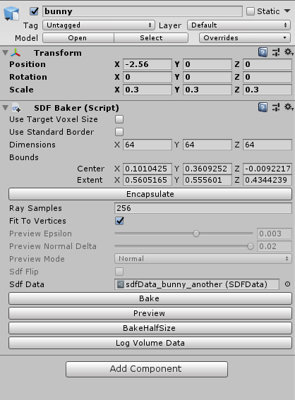
SDF Baker
SDFBaker.cs a stand-alone behavior script that can be hung on objects with mesh or children containing mesh SDFBaker's collection of all mesh under this object Is Offline baked Out SDF data, and the baking results are written to disk for reuse and instantiation of object components

Slide 5
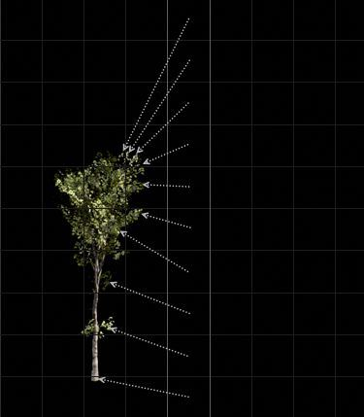
SDF计算方法
A brief description of the method: Emit many sampling rays from the center of each carnouseros, Violently solve the plane distance closest to each sampling point Algorithm details Distinguish ingmisse with HitBack count Use slightly larger AABB to prevent edge problems Recalculate the center and size of AABB to address the inconsistency between the anchor and the center of the object Defects: Non-uniform scaling can be wrong

Slide 6
SDF类图
SDF Baker is an implementation based on the virtual class AVolume Baker, as the algorithm above is rewritten in the Bake () function. The sDFBaker, SDFData and other classes used throughout the project are inherited or implemented for volume baking base classes.
*图中“聚合”箭头实际为“组合”

Slide 7
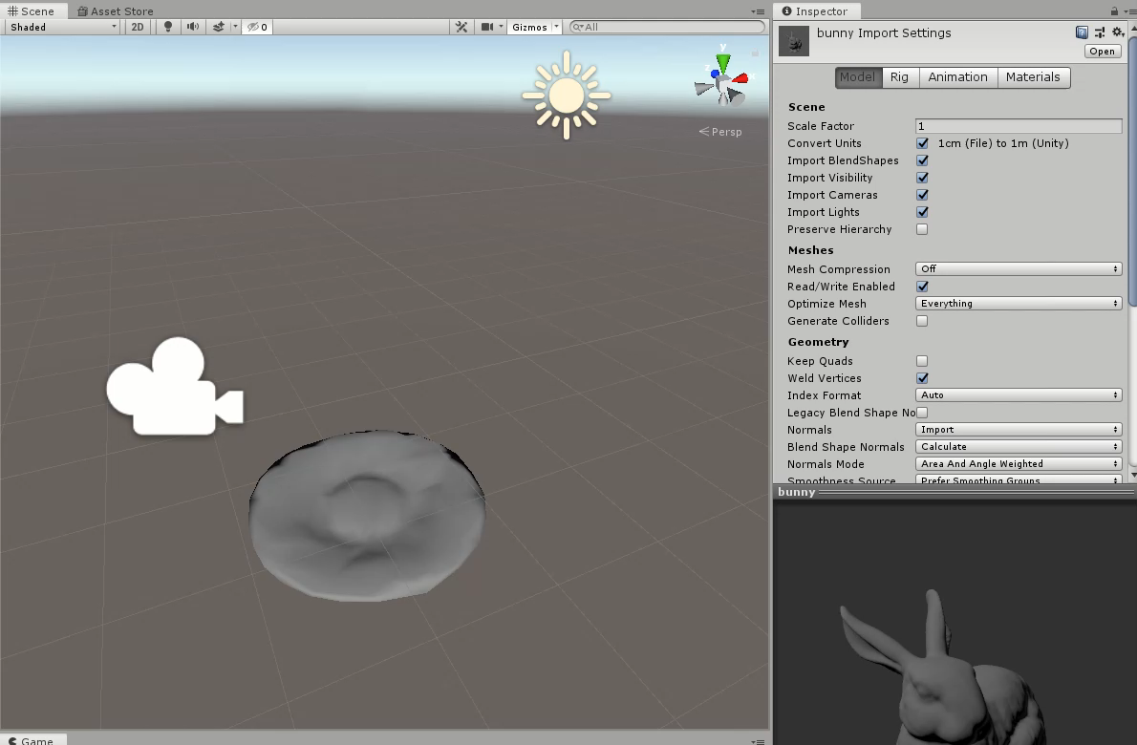
SDFBaker用例

Slide 8
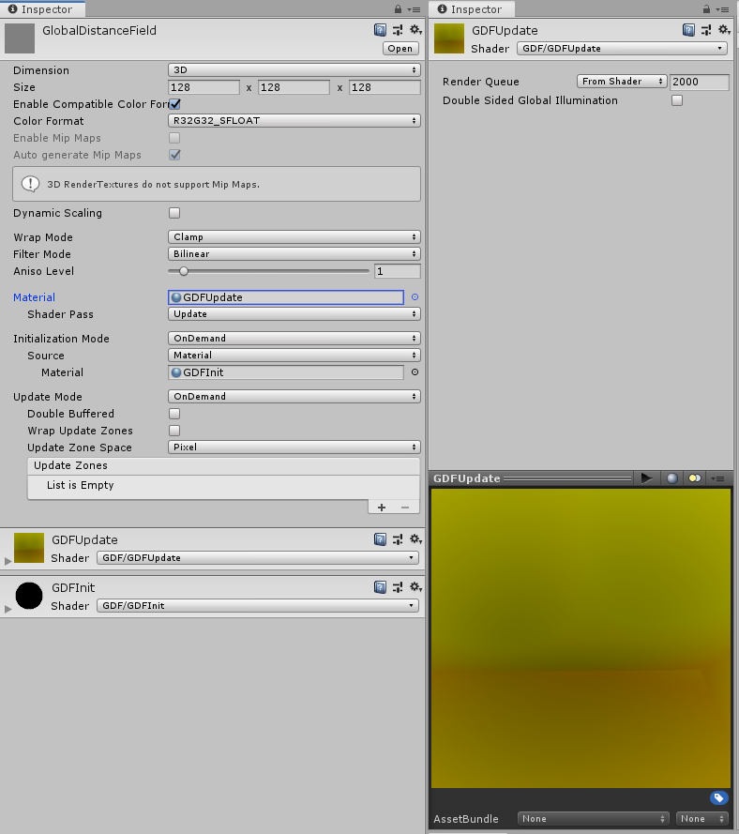
全局距离场 计算与更新

Slide 9
全局距离场 计算与更新
DistanceFieldAtlas.cs： At the beginning of execution, detect all objects in the scene that include SDF components, cache their SDF instances, and weight them according to the SDF file name used; The equal width (actually the exact same dimension) SDF Texture is injected into a separate Texture3D and passed to the GPU end. If there are 3 643 SDFs in the scene, the texture size is 64x64x192. This operation only needs to be performed once. GDF is a low-resolution Custom Render Texture size of 643 or 1283 Maintain spatial transformation information for all objects with SDF, detect the activation of objects per frame (GameObject.activeSelf) and whether the transformation occurs (Transform.isChange), and, if so, trigger update events The GDF update is done by a Shader, and updating the GDF requires the transfer of the StructuredBuffer <VolumeData>, i.e. spatial transformation and AABB information for all objects in the scene, as well as a number of parameters.

Slide 10
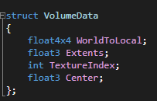
全局距离场 计算与更新
GDFUpdate.shader: For each fragment, get its uv coordinates and transform to the world coordinates of the GDF carnouspresses it represents (replace with p below)
Define the VolumeData structure at the shader end in GDFTexturing.hlsl
for (vd in StructuredBuffer<VolumeData>) :
if ( InsideAABB(p, vd) ):
dist = SampleAtlas(textureAtlas, vd.TextureIndex, p)
else:
dist, dist2* = GlobalAABBPlus(textureAtlas, vd.TextureIndex, p)
minDist = min(dist, minDist);
Notes:
* dist2后面详述

Slide 11
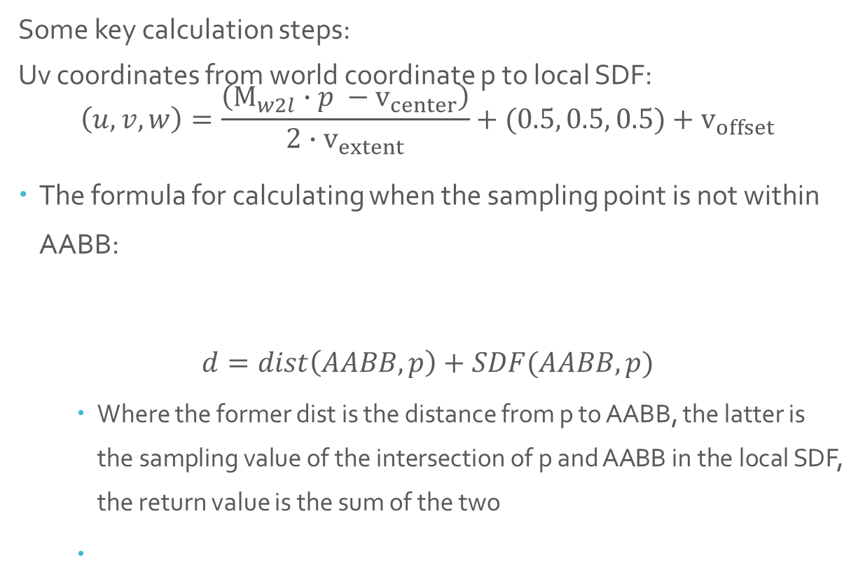
全局距离场 计算与更新
Some key calculation steps: Uv coordinates from world coordinate p to local SDF: $\left(u,v,w\right)=\frac{\left(M_{w2l}∙p −v_{center}\right)}{{2∙v}_{extent}}+(0.5, 0.5, 0.5)+v_{offset}$
The formula for calculating when the sampling point is not within AABB:
$$d=dist\left(AABB, p\right)+SDF(AABB,p)$$
Where the former dist is the distance from p to AABB, the latter is the sampling value of the intersection of p and AABB in the local SDF, the return value is the sum of the two
dist
clamp
AABB Inside
SDF
Notes:
v_offset 与textureIndex相关，由于textureAtlas的深度与长宽不同，每一个texture的实际uv范围只对应其中的一小部分，需要计算一个offset代表texture在整体中的深度偏移

Slide 12
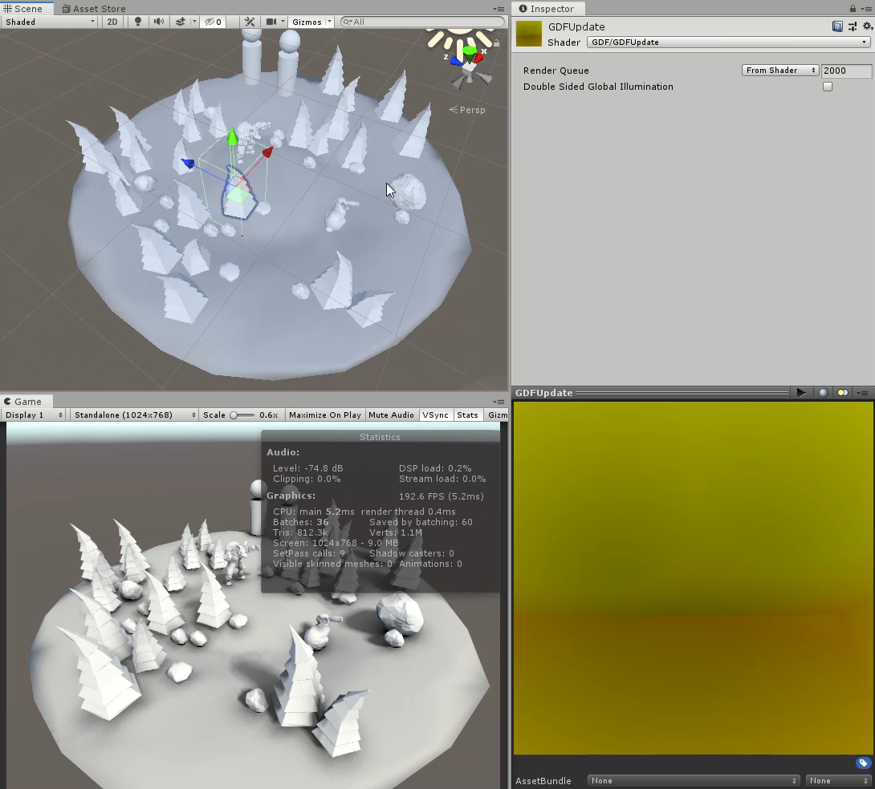
GDF实时更新

Slide 13
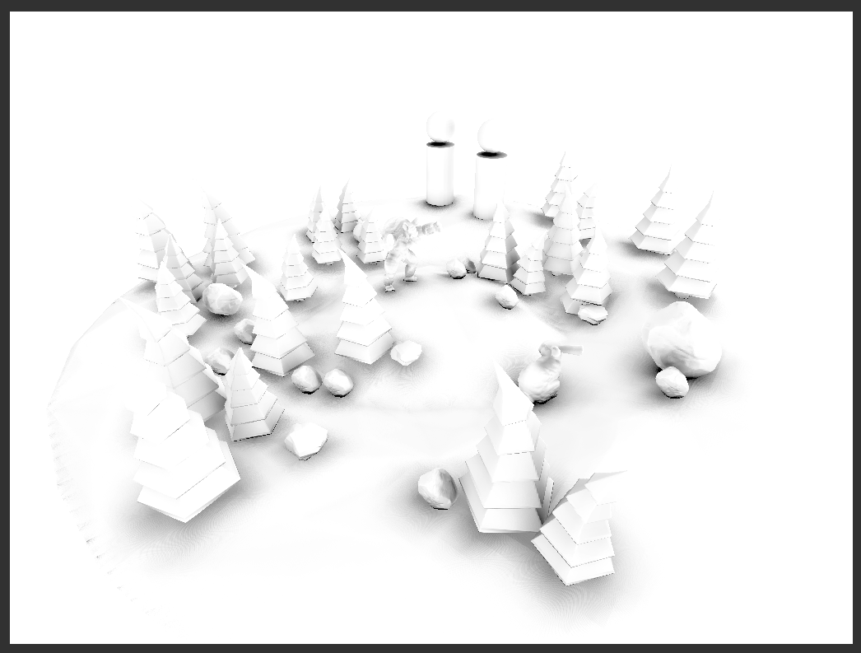
GDF应用 环境光遮蔽

Slide 14
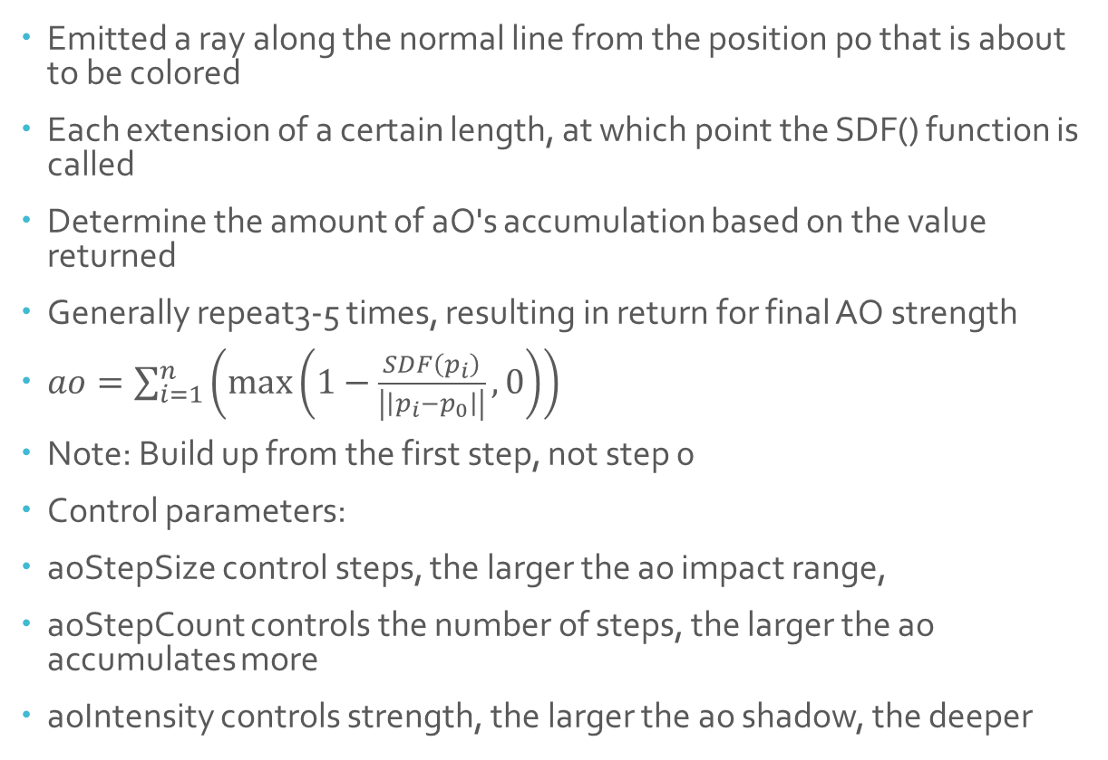
GDF应用 环境光遮蔽
Emitted a ray along the normal line from the position p0 that is about to be colored Each extension of a certain length, at which point the SDF() function is called Determine the amount of aO's accumulation based on the value returned Generally repeat3-5 times, resulting in return for final AO strength $ao=\sum_{i=1}^{n}{\left(\max\left(1−\frac{SDF\left(p_{i}\right)}{\left|\left|p_{i}−p_{0}\right|\right|}, 0\right)\right) }$
Note: Build up from the first step, not step 0 Control parameters: aoStepSize control steps, the larger the ao impact range, aoStepCount controls the number of steps, the larger the ao accumulates more aoIntensity controls strength, the larger the ao shadow, the deeper
p₄
p₃
p₂
p₁
p₀

Slide 15
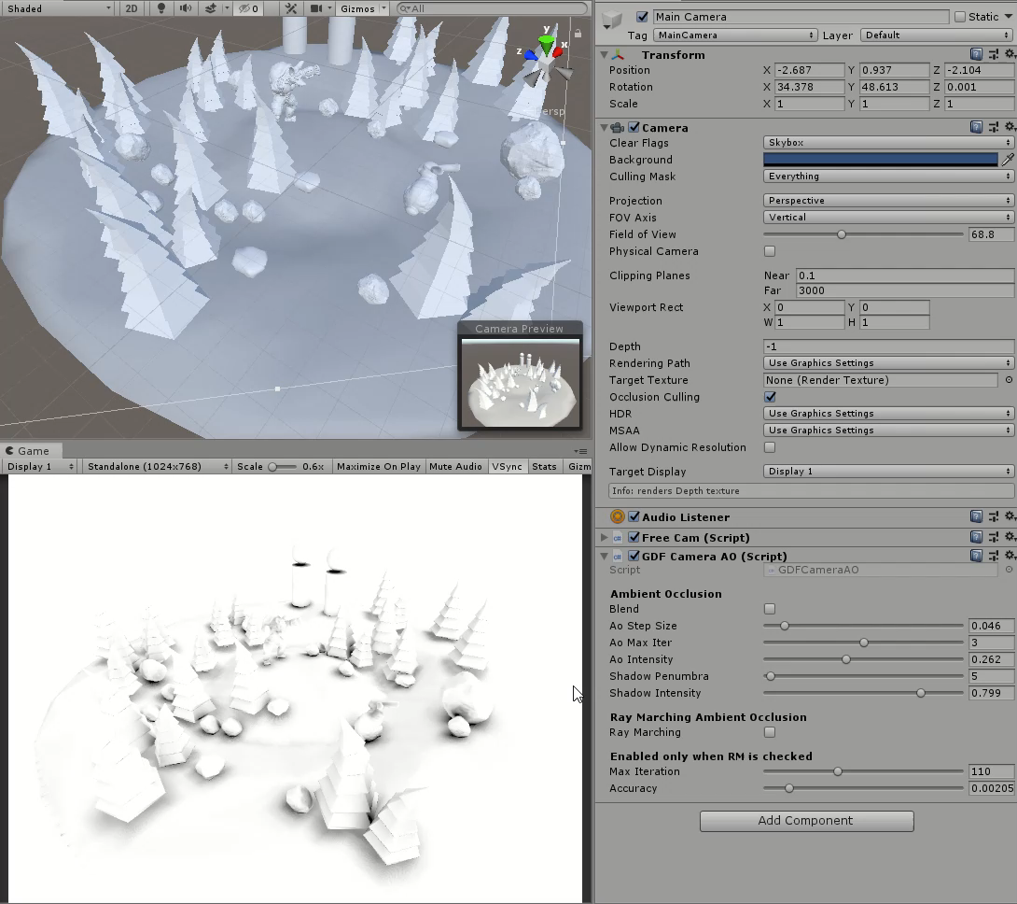
CameraSpaceAO

Slide 16
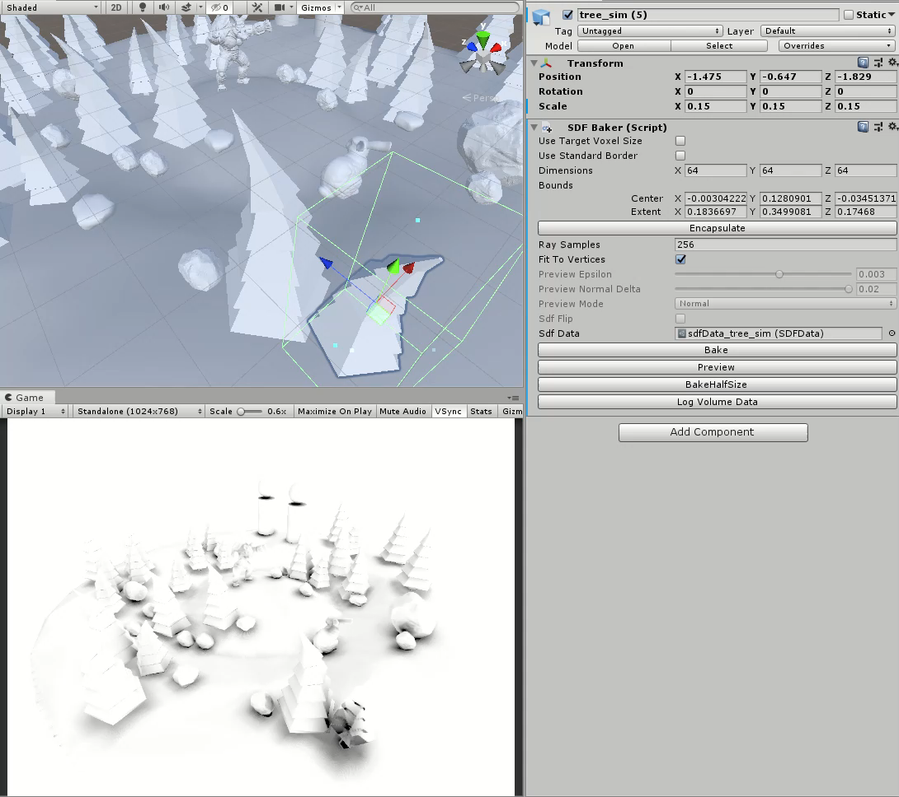
SingleAO

Slide 17
AO实现 思考与细节
There are two ways to view AO in the project, the first of which is cameraSpaceAO, which previews the AO effects of all objects from the camera's perspective, and runs its corresponding shader to turn on the CameraDepthTexture feature, using p for each pixel. WorldCameraPos and ViewDir and depth restore the world coordinates of the pixel corresponding to the element, and then perform AO calculations. Under global conditions, the normal information of the surface of the object is lost, to make differentials to the GDF to seek the flat method direction, so do some error (because the GDF sampling rough), but the three linear difference ensures that the differential results have at least second-order continuity, so this method will not cause visual effect errors. The other is to preview the AO material of a single object and drag it onto an object to see its distance from other objects, in which case the normal direction of the plane can be obtained directly from the vertex shader, avoiding sdit-to-face SDF calls with less overhead. When there are fewer objects using SDF in the scene, it is recommended to mount the material (and turn on material instantiation) for each object instead of using the first method.

Slide 18
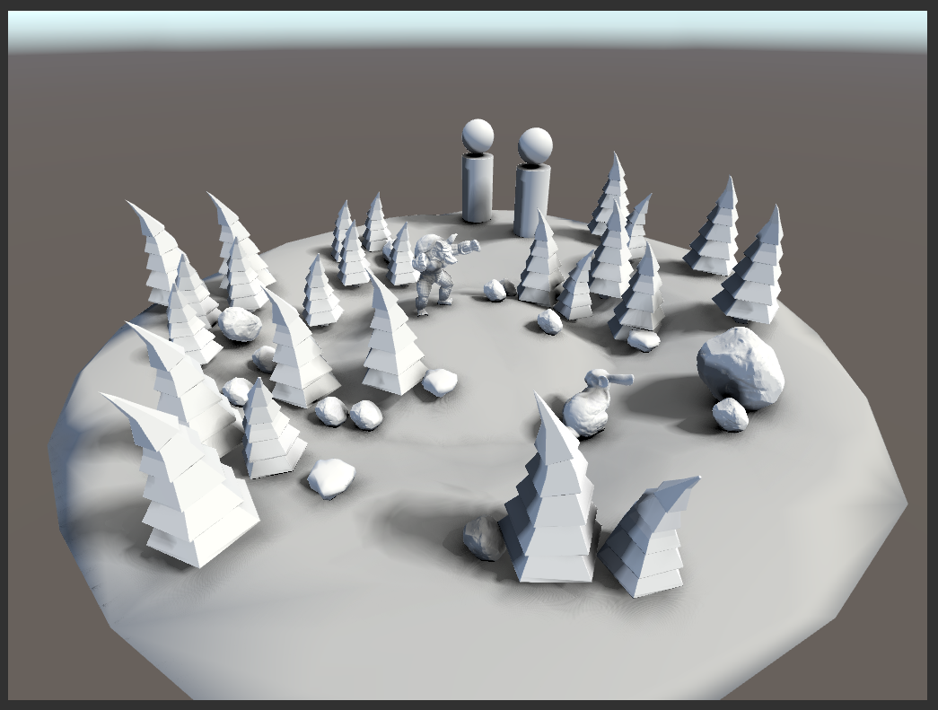
GDF应用 软阴影

Slide 19
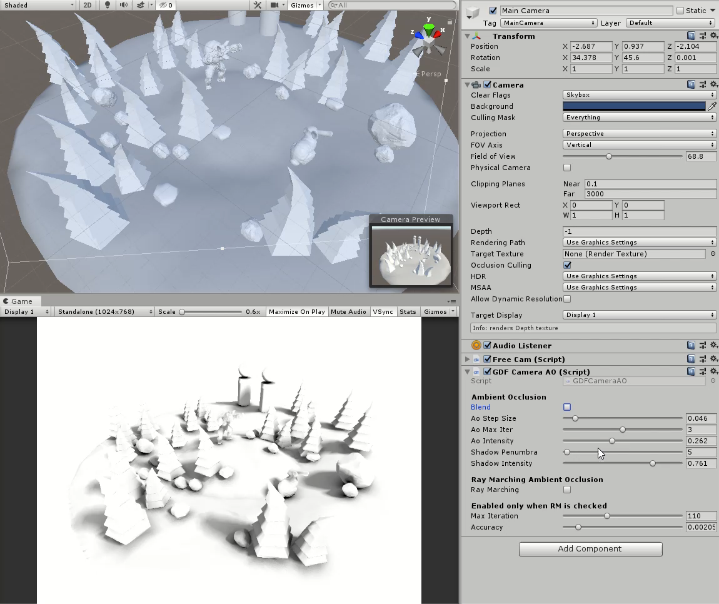
阴影效果预览

Slide 20
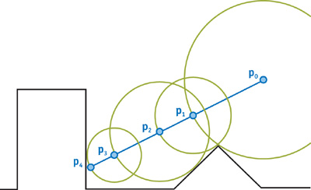
基本原理
Ray Marching: Ray Tracing Algorithm snofarfrom the field Since each point p in space maps to its distance to the nearest plane, d-SDF(p), you can jump the length of d directly in the direction of light propagation and do this repeatedly until a point d value is less than a certain threshold and is considered a point of intersection with the light and the plane.
Soft shadows are calculated by emitting a ray to the light source from each element to be colored, using Ray Marching to step toward the cut-off of the light. Soft shadows distinguish between full and half shadows, producing full shadows when rays collide directly with objects, and rays travel closer to certain objects (i.e., "sweeping" objects).

Slide 21
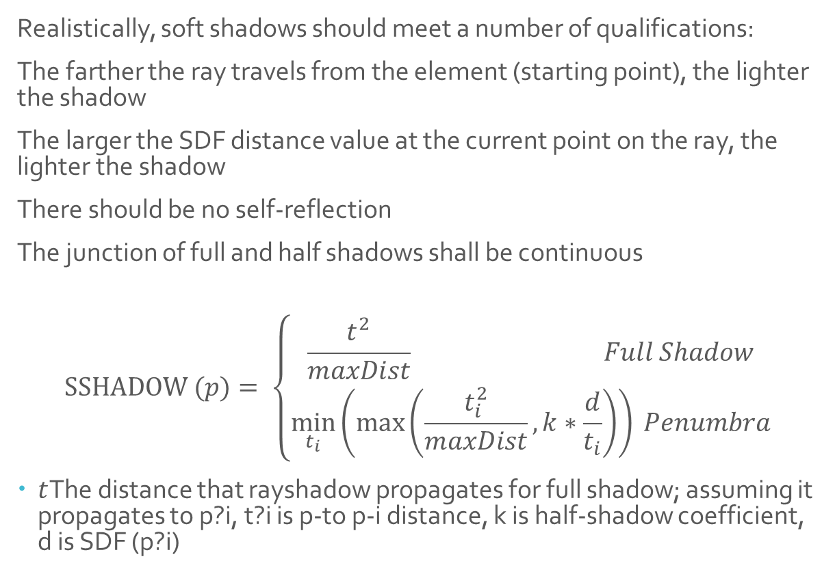
软阴影 计算要点
Realistically, soft shadows should meet a number of qualifications: The farther the ray travels from the element (starting point), the lighter the shadow The larger the SDF distance value at the current point on the ray, the lighter the shadow There should be no self-reflection The junction of full and half shadows shall be continuous
$$SSHADOW (p)= \left\{\begin{aligned}\frac{t^{2}}{maxDist} Full Shadow \\ \min_{t_{i}}\left(\max\left(\frac{t_{i}^{2}}{maxDist}, k∗\frac{d}{t_{i}}\right)\right) Penumbra\end{aligned}\right.$$
$t$The distance that rayshadow propagates for full shadow; assuming it propagates to p?i, t?i is p-to p-i distance, k is half-shadow coefficient, d is SDF (p?i)

Slide 22
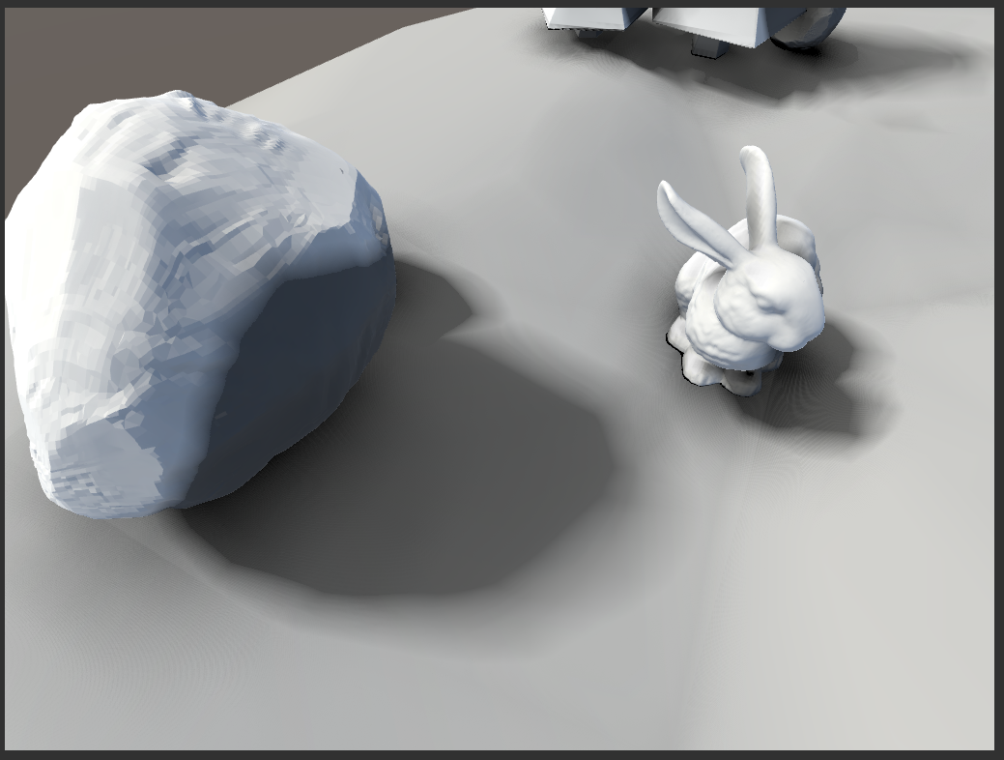
近距离查看
Notes:
有Moire效应，这个暂时没思考解决办法

Slide 23
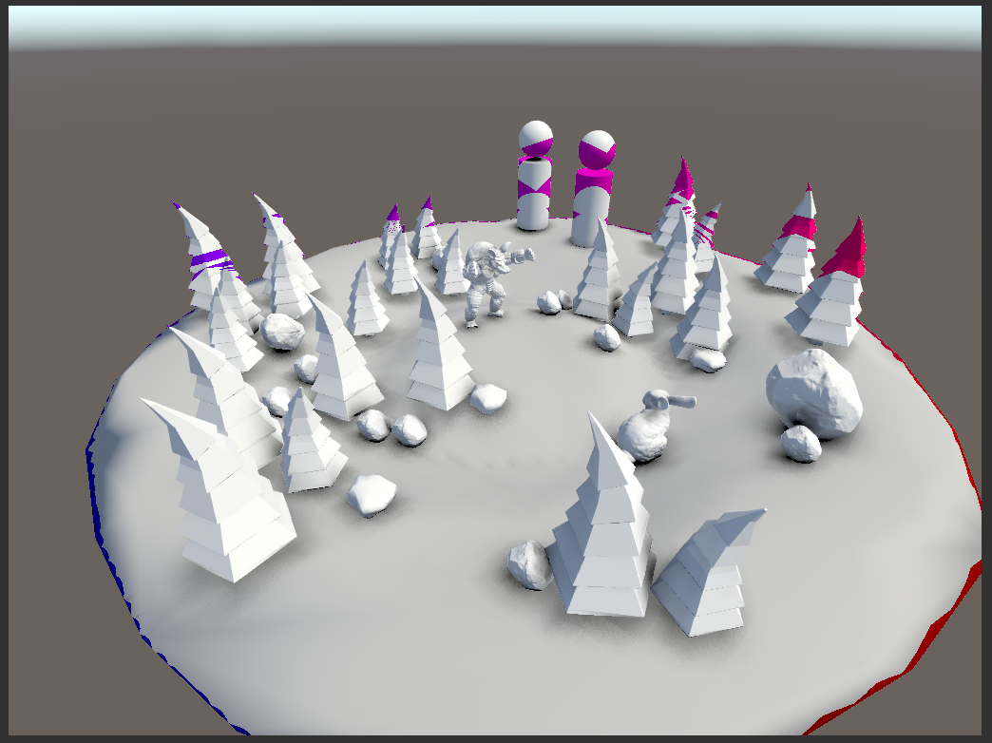
细节问题与 解决方案
When using inaccurate distance fields, RM has problems: Because the GlobalAABBPlus() function does not return a conservative distance value, when the ray angle is not the same as the original calculation angle, its step length may "cross" the object, resulting in an error in the location calculation that should have been hit.
Errors are common in: Very regular-shaped objects Thin or sharp position AABB flat plane method angled to A ShadowRay very large position
dist
clamp
AABB内部
SDF

Slide 24
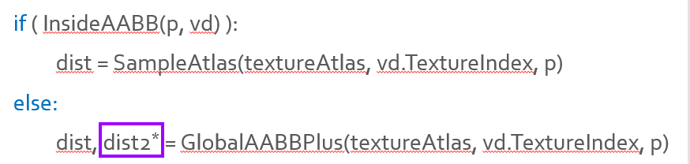
细节问题与 解决方案
When using inaccurate distance fields, RM has problems: Because the GlobalAABBPlus() function does not return a conservative distance value, when the ray angle is not the same as the original calculation angle, its step length may "cross" the object, resulting in an error in the location calculation that should have been hit.
Solution: In GDF, when the sampling point is not within AABB, a ValueWig is calculated at the same time, so that the step value must not be an error cvalue = max(dist, SDF(hitPoint)) When calculating ShadowRay Marching, take Plus as the reference value to the nearest plane, and "Large value" as the next step
较大
加和
dist
clamp
AABB内部
SDF

Slide 25
可能的疑问与解答
When GDF updates the value of each sampling point, if it is not within an AABB, why not take "the point to AABB distance" as its sample value? Consider: Number of iterations of Ray Marching If the distance to AABB is stored, when the ray is nearly parallel to the AABB plane, it takes a very many iterations to reach the AABB surface, and each iteration requires a reading texture operation, which is expensive. So while this method is very simple to calculate, the actual cost is unacceptable.
In contrast, cvalue is a larger value from the external to Abbf distance and the internal SDF, which avoids taking smaller external values multiple times when the ray is near the edge, thus entering the enclosure with fewer iterations
AABB内部

Slide 26
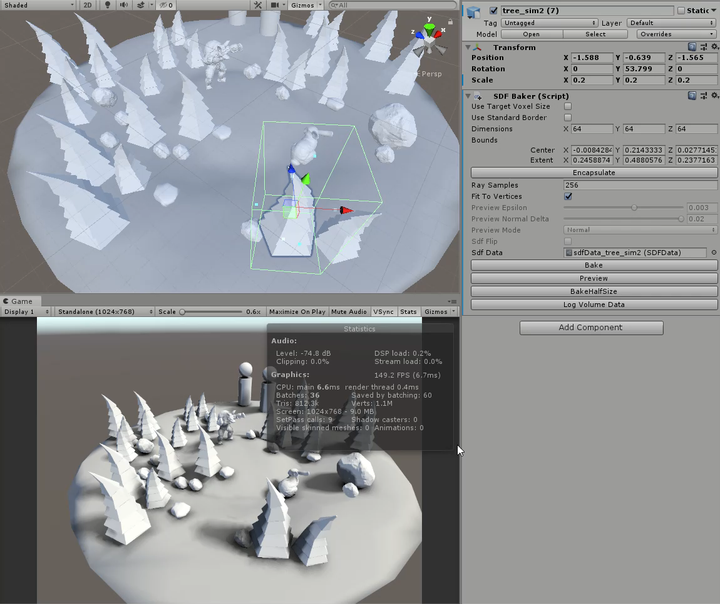
效率和效果

Slide 27
Thank you! Application of distance field in shadow rendering
导师：聂明华
周洋 HZS13760

